Slide 1

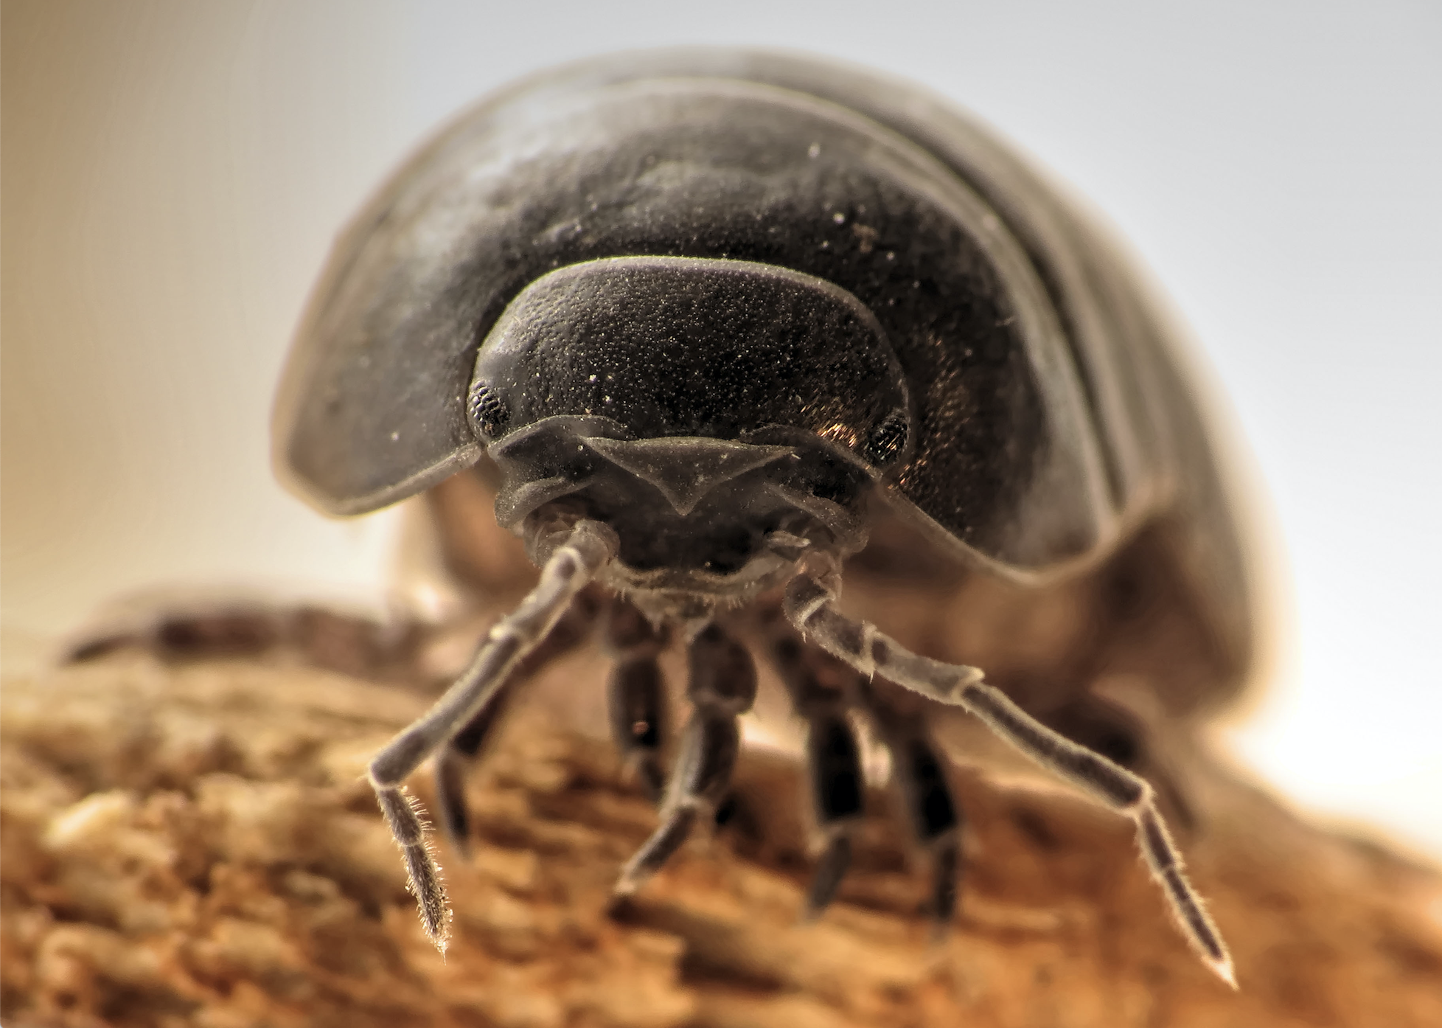
Pill Bug
—

Slide 2
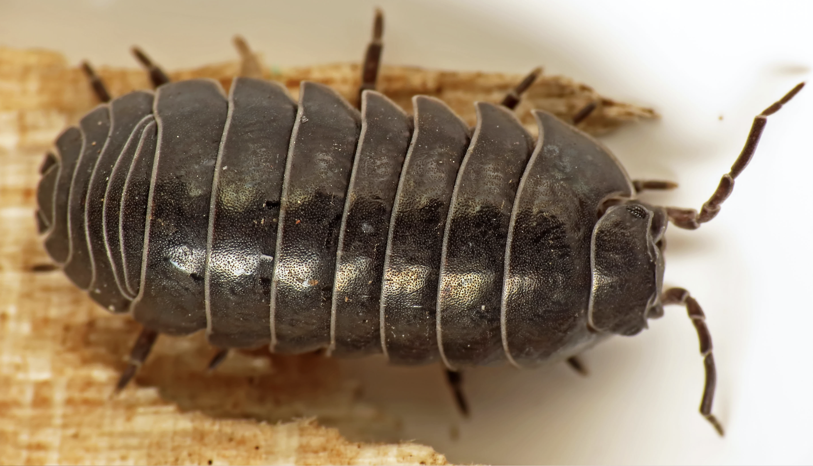
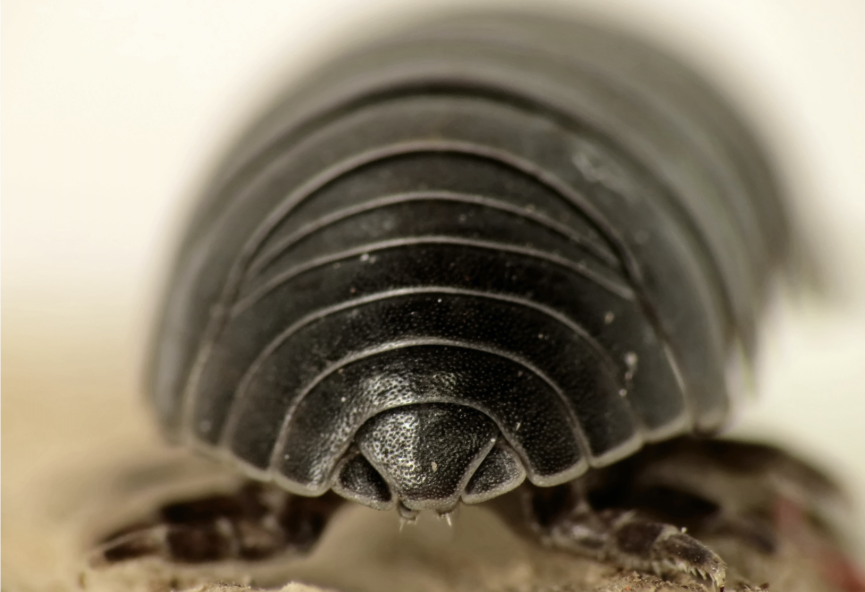
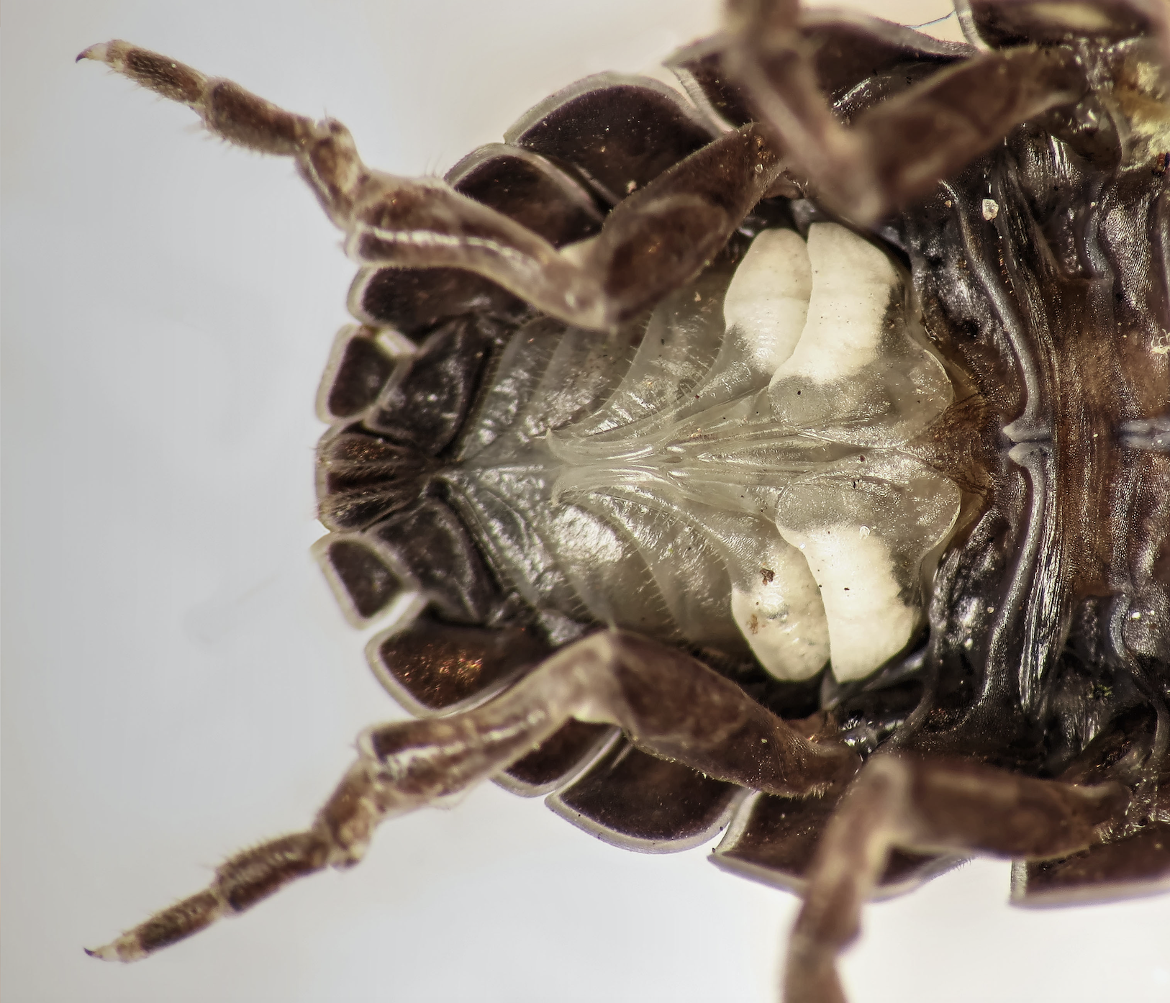
Pill Bug
Armadillidium vulgare (male) by
Martin Cooper Ipswich is licensed under
CC BY 2.0

Slide 3
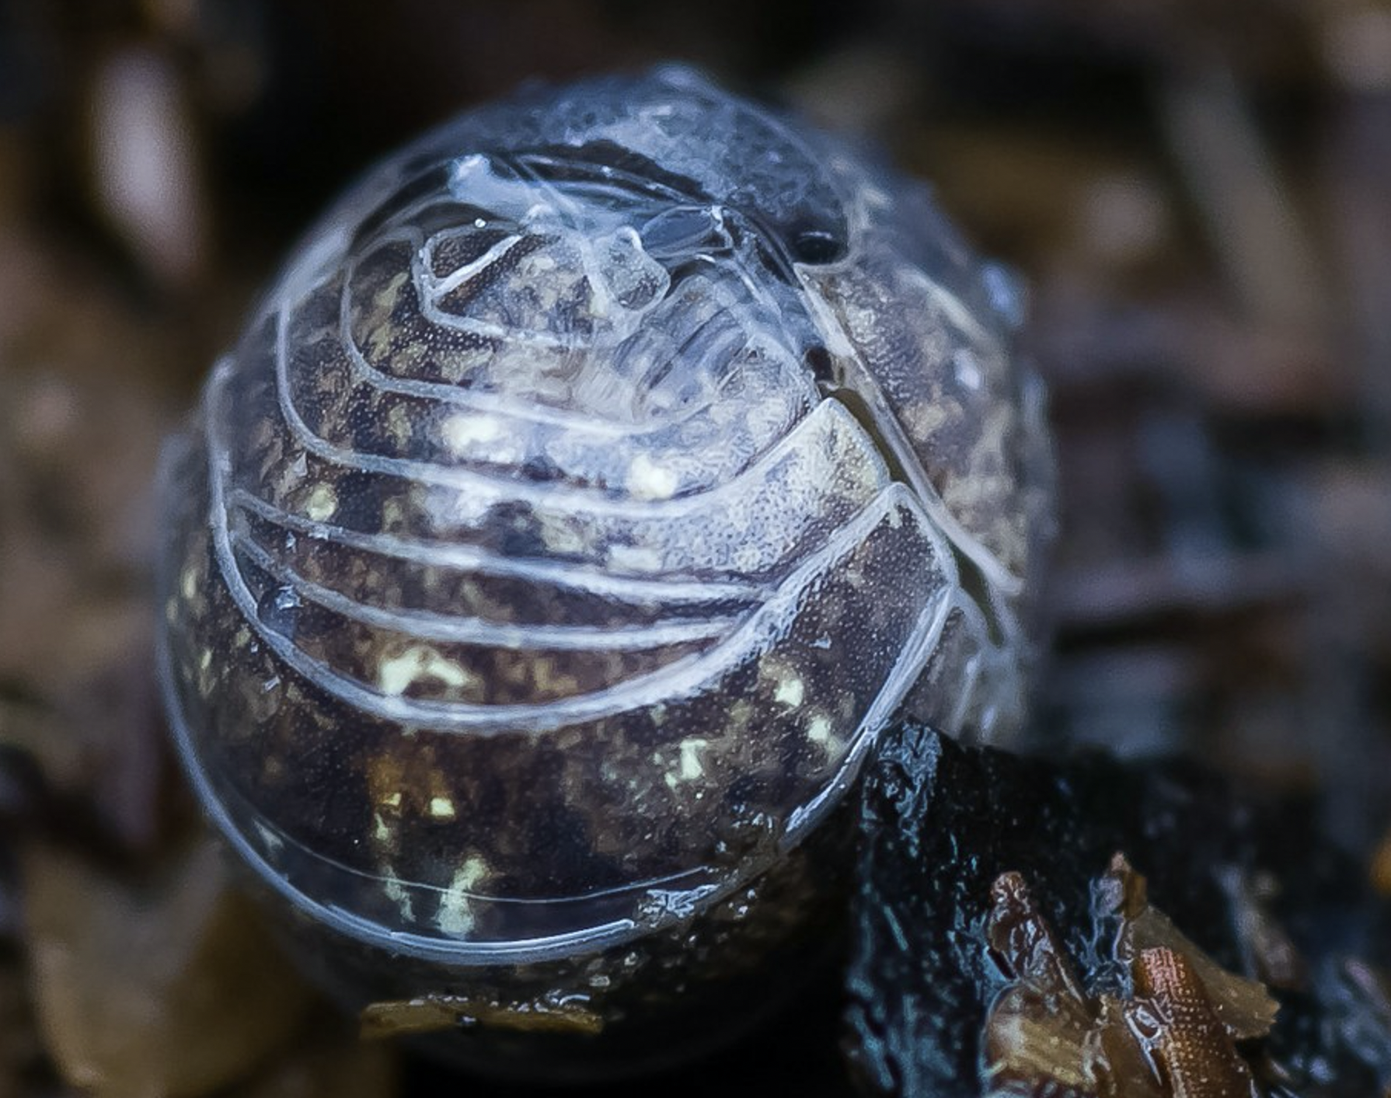
Pill Bug Balled Up
Pill Bug: Armadillium vulgare by
Cletus Lee is licensed under
CC BY-NC-ND 2.0

Slide 4
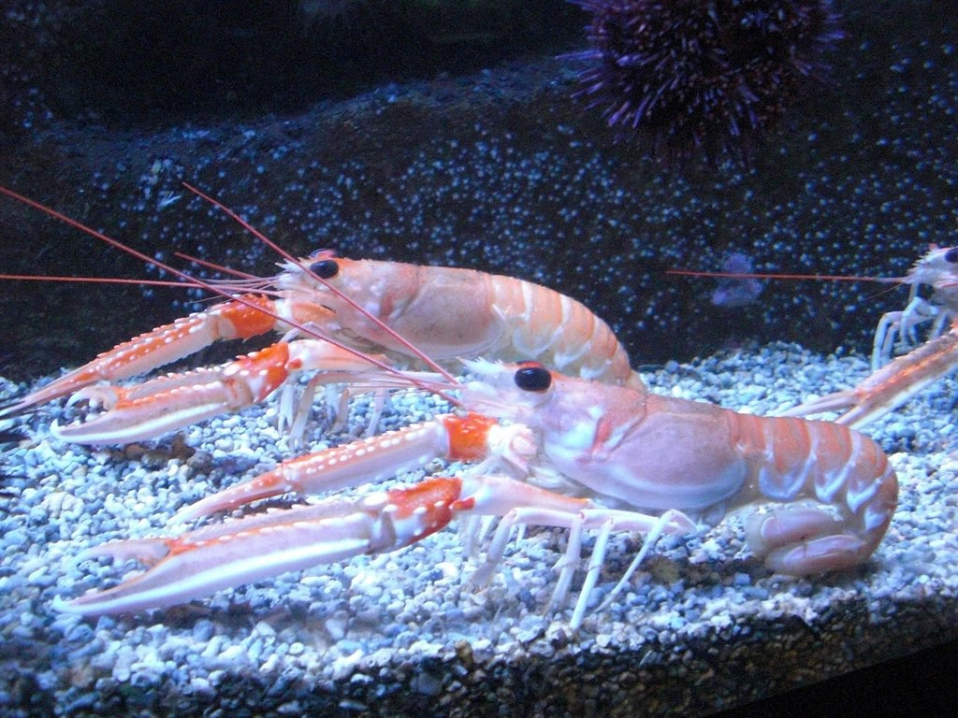
Shrimp
Langoustines by Cochonou
is licensed under CC BY-NC-SA 2.0

Slide 5
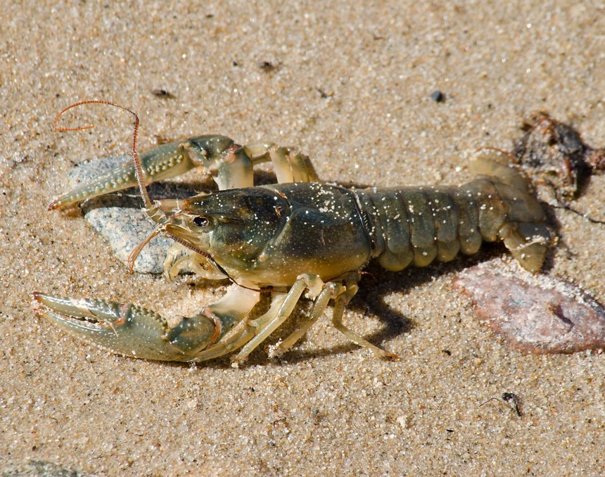
Crayfish (Crawdad)
Crayfish 4 by Christa R.
is licensed under CC BY-NC 2.0

