Slide 1

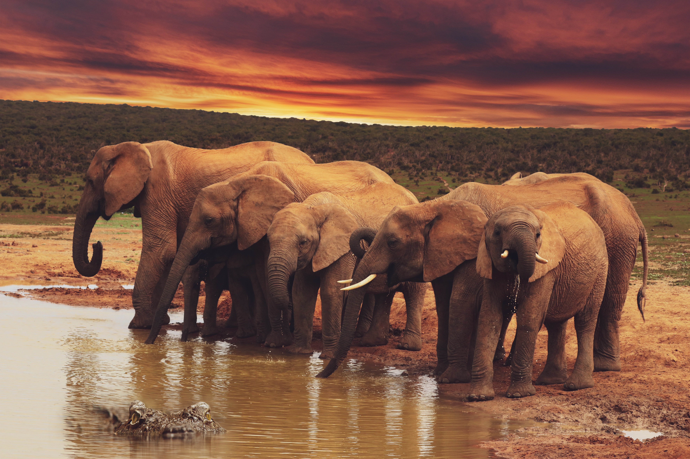
Environments
—
Living and Non-Living Components in a Habitat

Slide 2
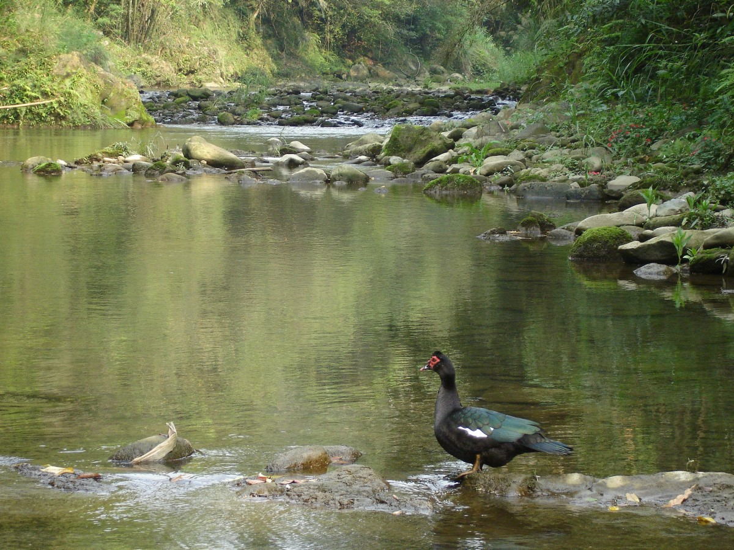
Pond
https://pxhere.com/en/photo/1612150?utm_content=shareClip&utm_medium=referral&utm_source=pxhere

Slide 3
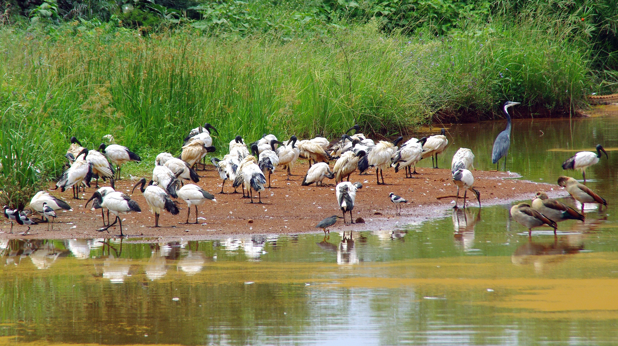
Wetlands
https://pxhere.com/en/photo/1055601?utm_content=shareClip&utm_medium=referral&utm_source=pxhere

Slide 4
Terrestrial / Grasslands
https://pxhere.com/en/photo/1604154?utm_content=shareClip&utm_medium=referral&utm_source=pxhere

Slide 5
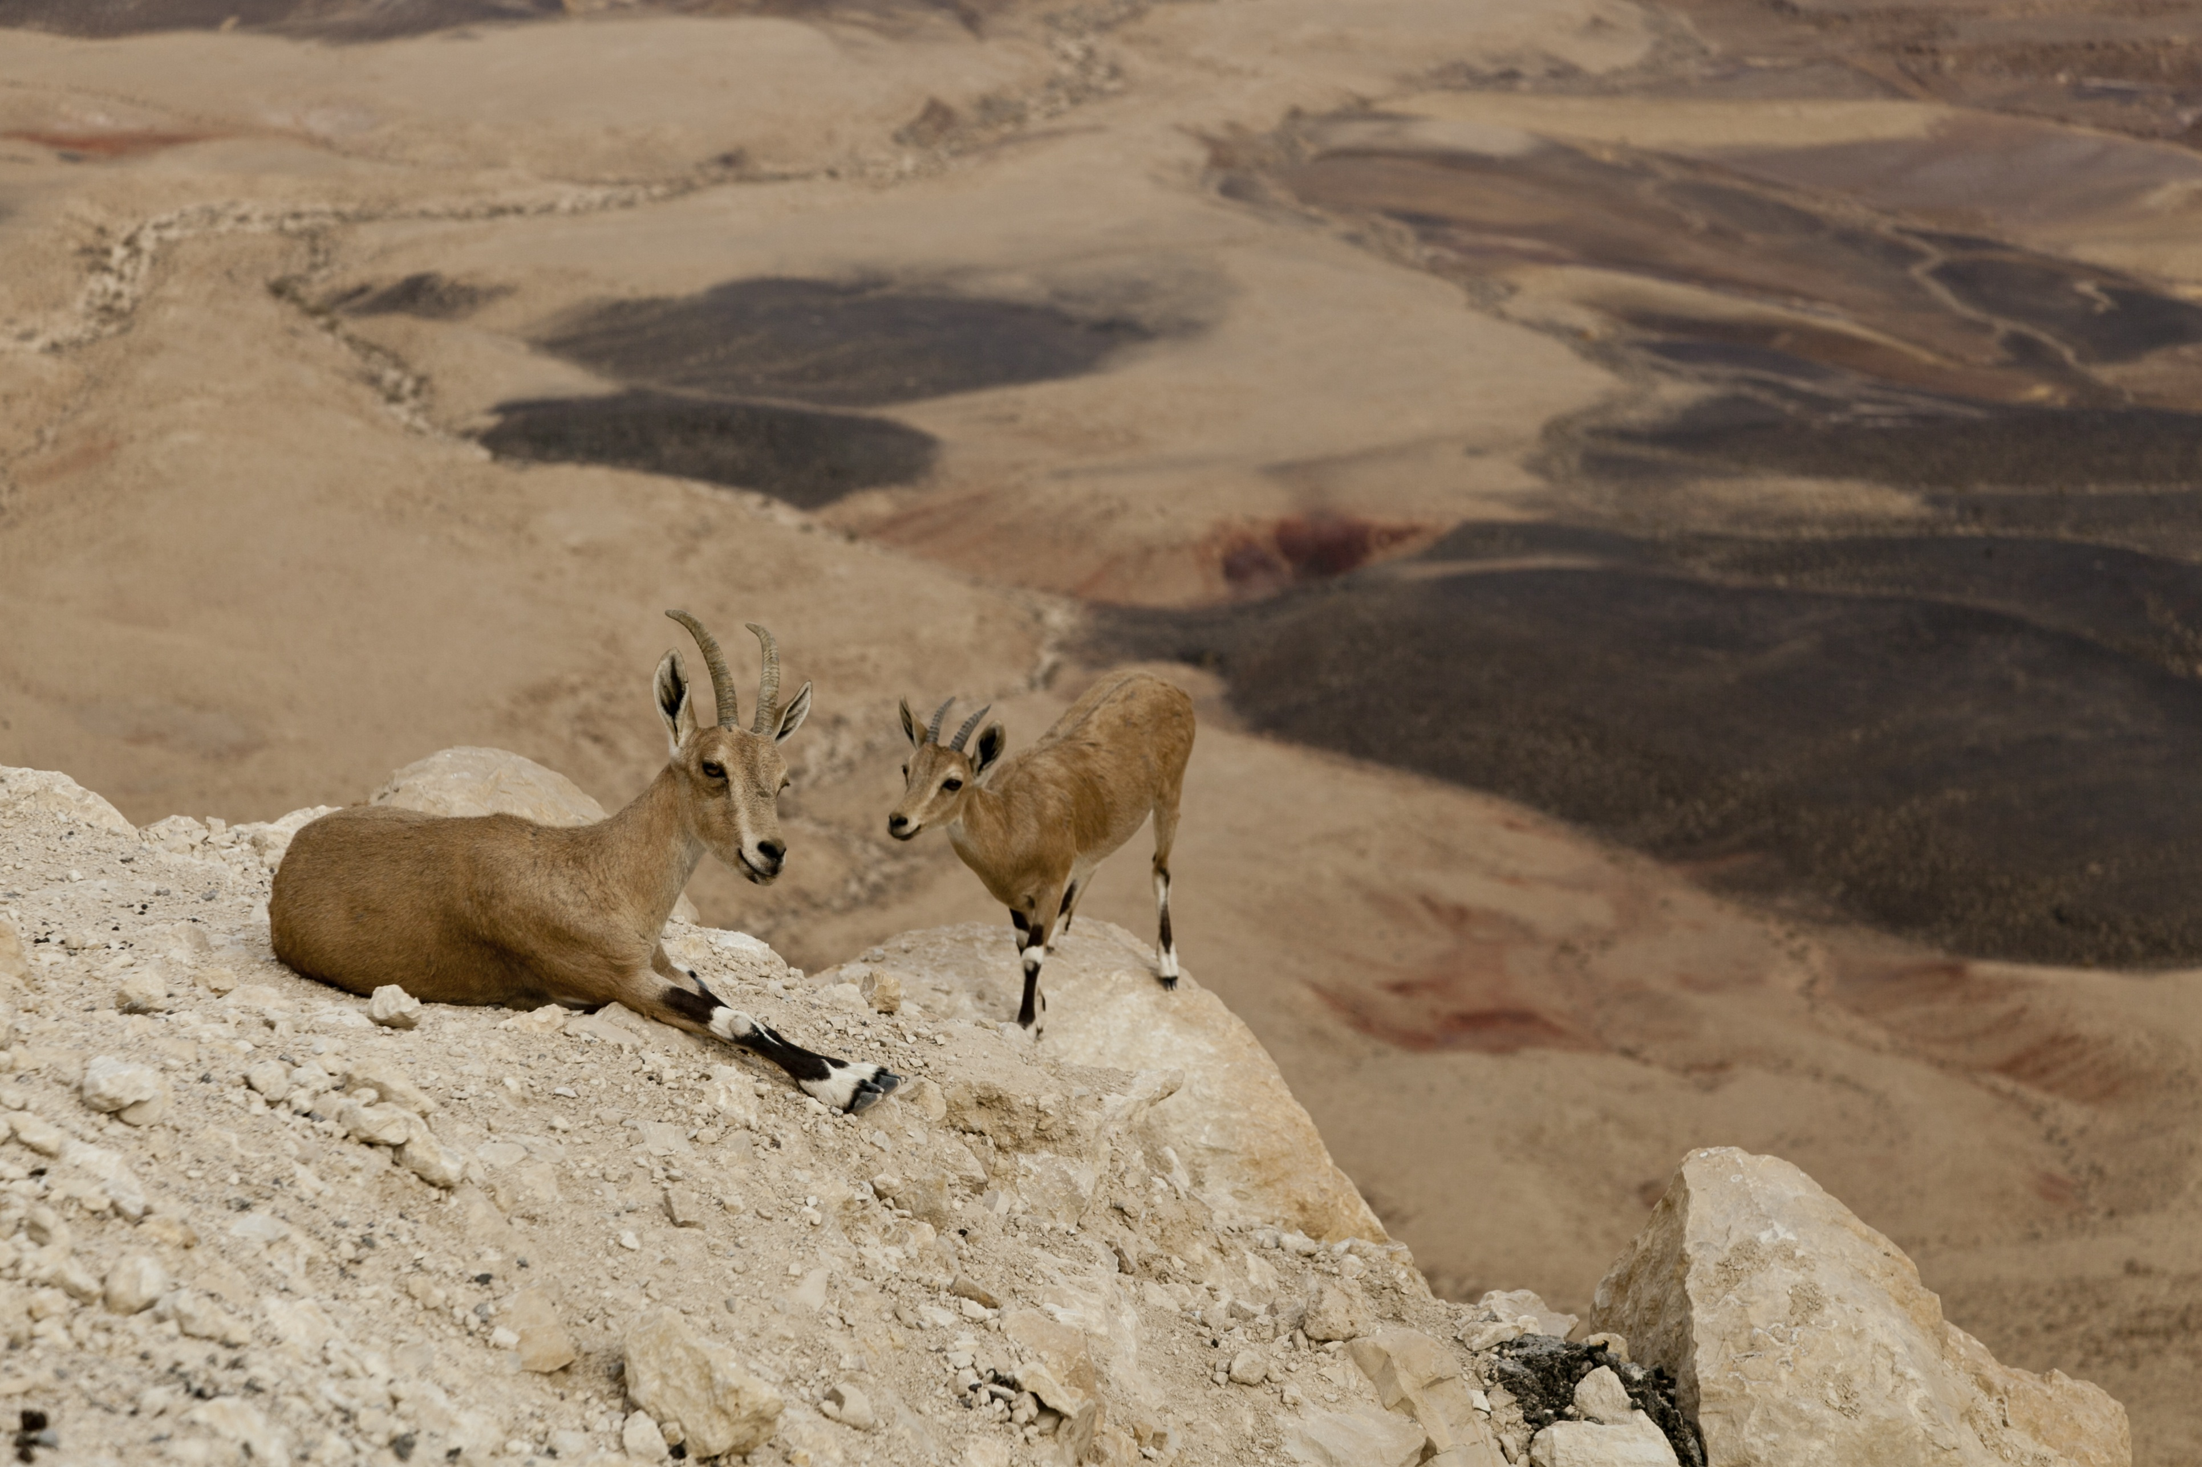
Mountain Terrain
https://pxhere.com/en/photo/655115?utm_content=shareClip&utm_medium=referral&utm_source=pxhere
https://pxhere.com/en/photo/655115?utm_content=shareClip&utm_medium=referral&utm_source=pxhere

Slide 6
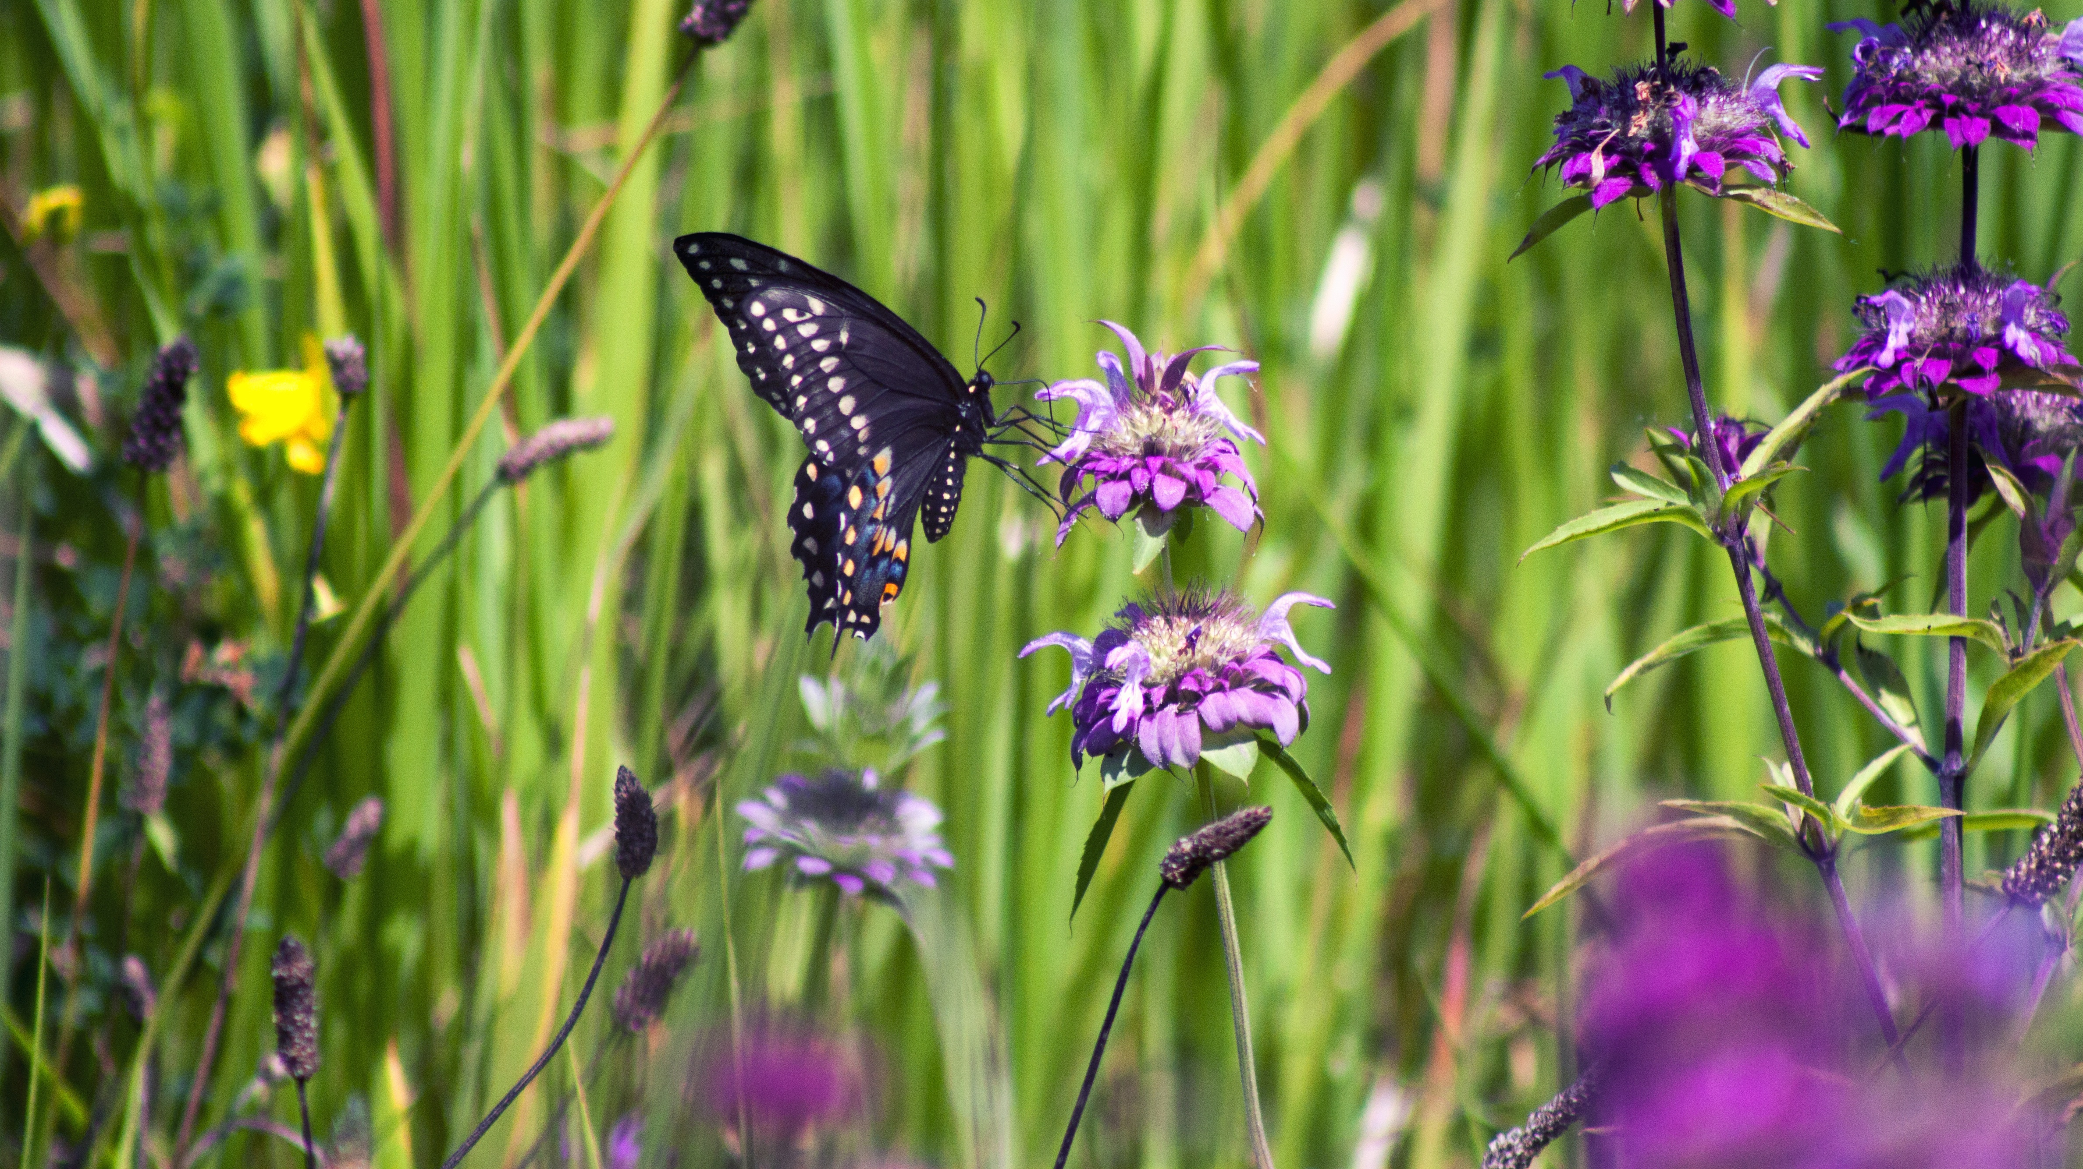
Garden
https://pxhere.com/en/photo/1612150?utm_content=shareClip&utm_medium=referral&utm_source=pxhere

Slide 7
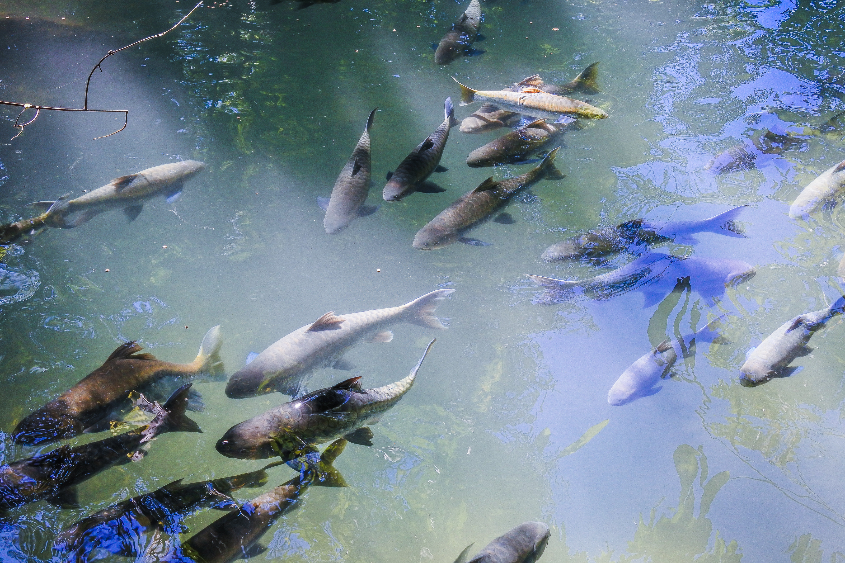
Aquatic
https://pxhere.com/en/photo/1578861?utm_content=shareClip&utm_medium=referral&utm_source=pxhere

Slide 8
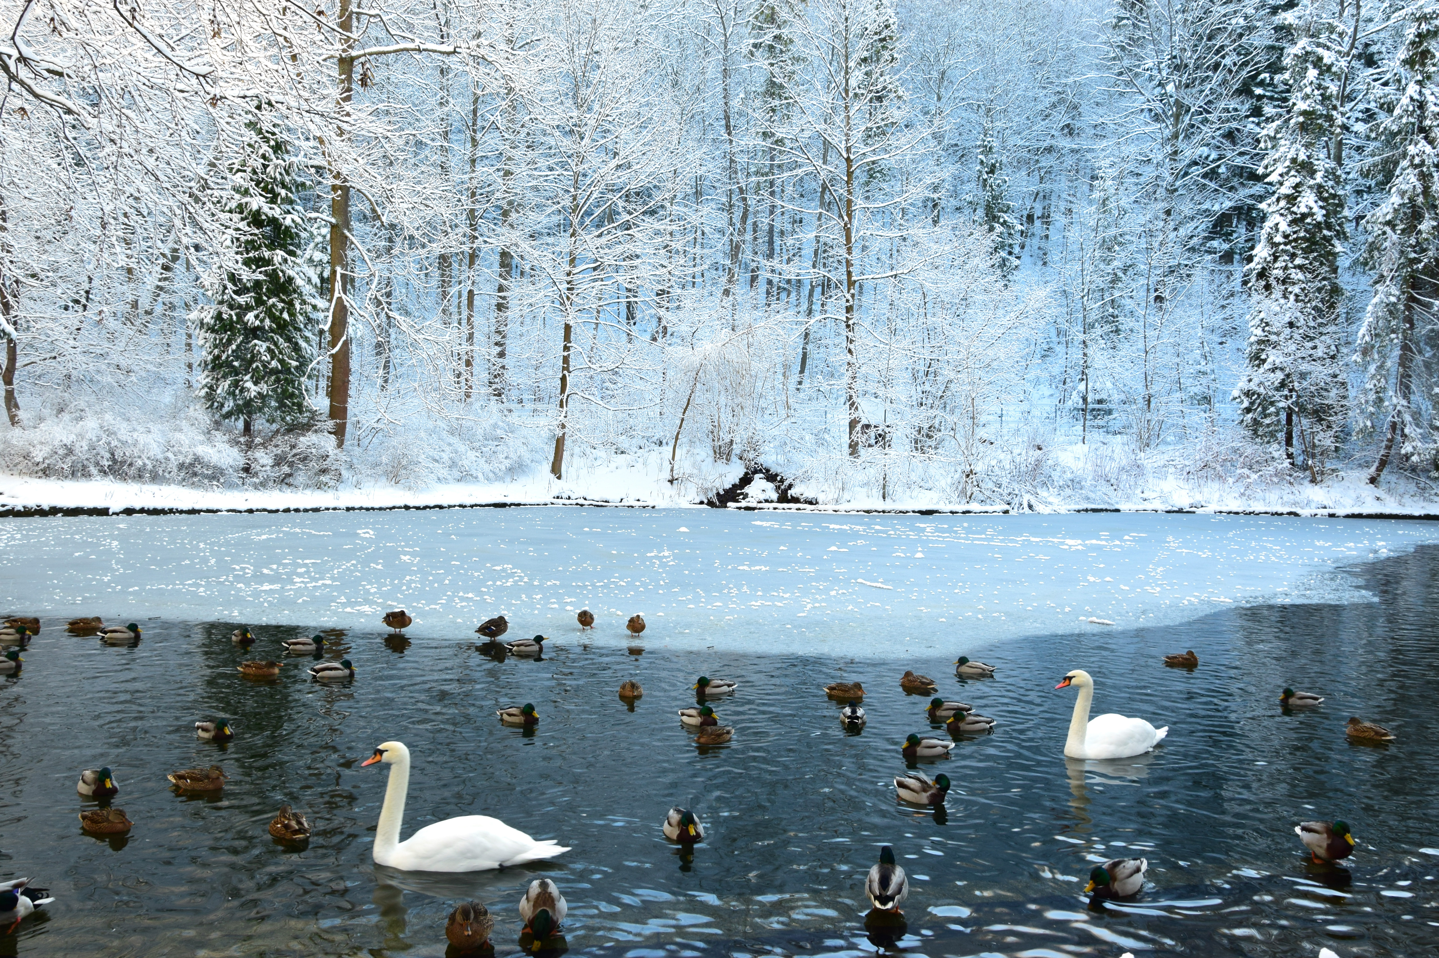
Forest / Lake
https://pxhere.com/en/photo/670793?utm_content=shareClip&utm_medium=referral&utm_source=pxhere

Slide 9
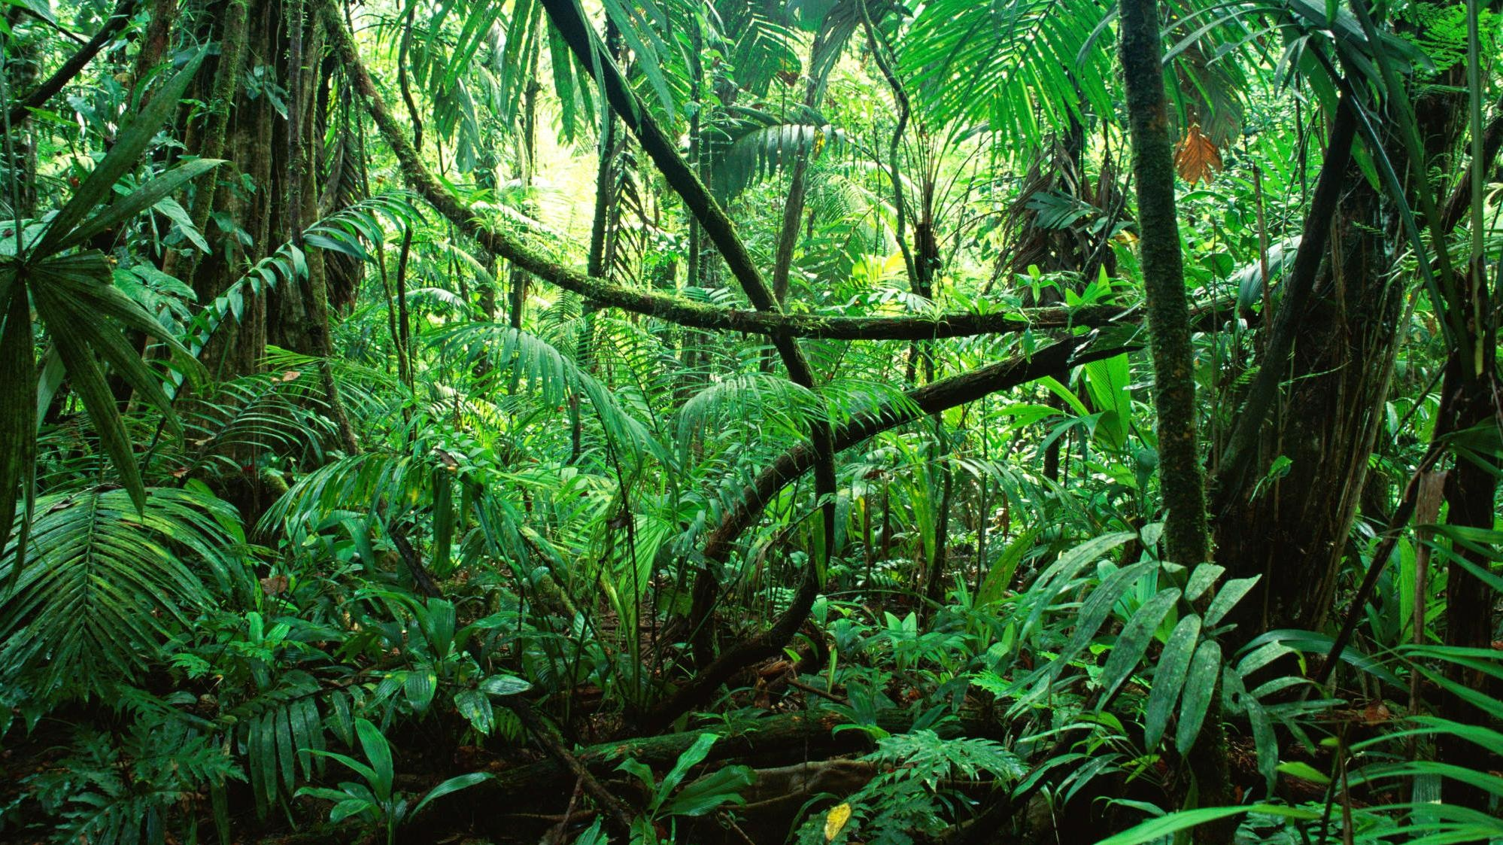
Tropical / Jungle
https://pxhere.com/en/photo/1604154?utm_content=shareClip&utm_medium=referral&utm_source=pxhere

Slide 10
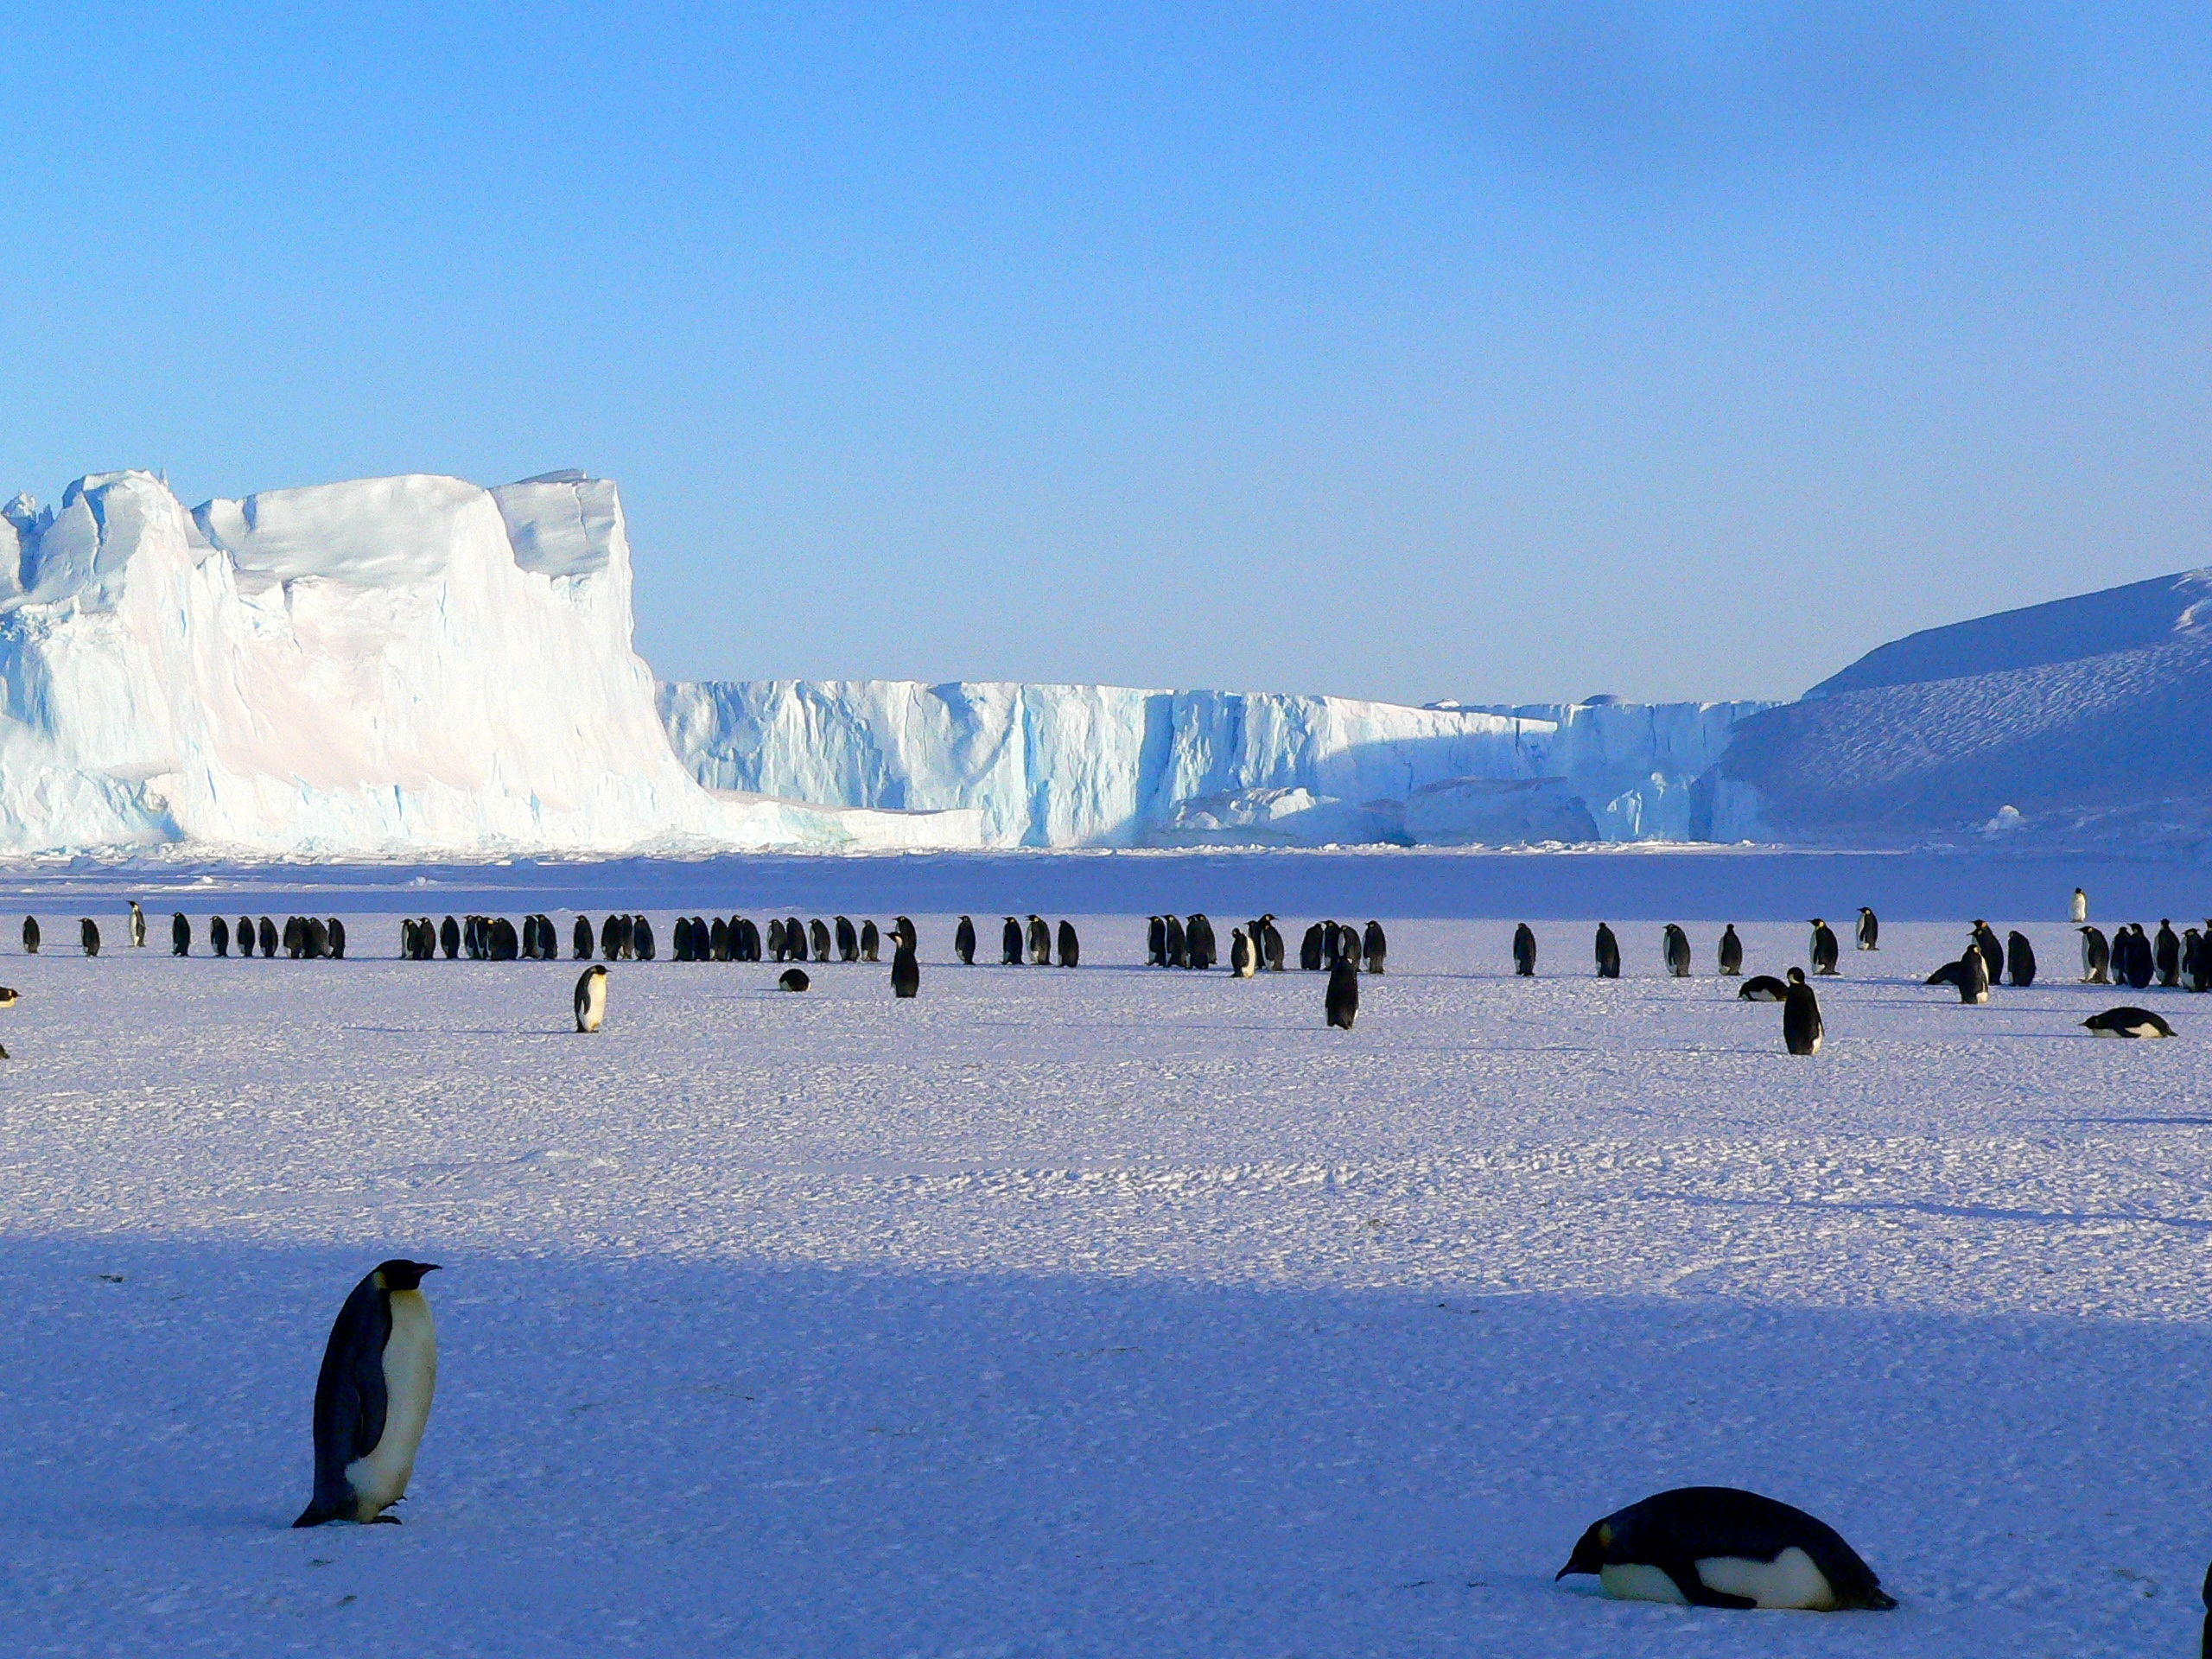
Antarctica / Polar
https://pxhere.com/en/photo/1083462?utm_content=shareClip&utm_medium=referral&utm_source=pxhere

Slide 11
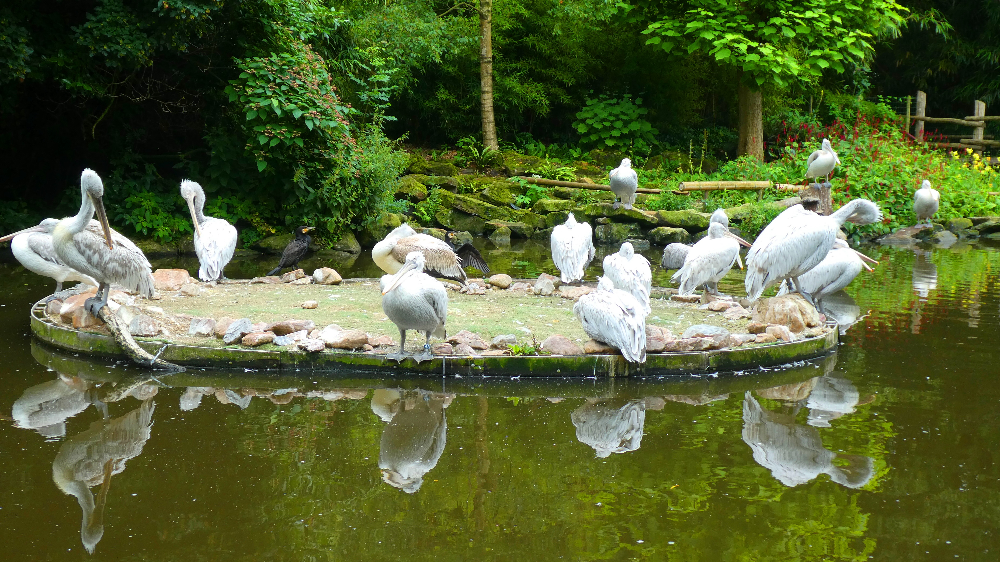
Nature Preserve
https://pxhere.com/en/photo/1597277?utm_content=shareClip&utm_medium=referral&utm_source=pxhere

